Slide 1
Multilocus phylogenetics show high levels of endemic fusaria inhabiting Sardinian soils (Tyrrhenian Islands)
https://core.ac.uk/reader/11691772?utm_source=linkout

Slide 2

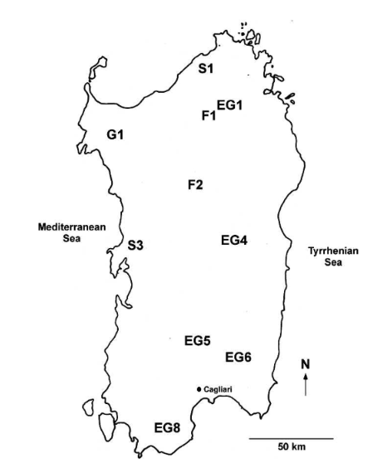
Research Process and Methods
1. Use of modified CTABprotocol for DNA extraction.
2. Amplification and sequencing of the elongation factor 1-alpha gene (EF-1α) and the second-largest RNA polymerase gene (RPB2).
- Sequential acquisition of three-locus haplotypes for 23 isolates in FSSC.
- Acquisition of two-locus haplotypes for 202 members of FOSC.
3. Sequence alignment and trimming of data with missing values.
- Use of COLLAPSE 1.1 software to condense multilocus sequences into haplotypes.
4. Use of the PAUP* 4.1.11 package for performing phylogenetic analysis on compressed multilocus data.
- Construction of maximum parsimony trees using heuristic search methods and bootstrap testing for reliability.
5. Use of the Bray-Curtis similarity measure for clustering and ordination analysis of the data.
6. One-way ANOSIM test to assess the significance of differences between ecosystems.
- Calculation of Spearman's rank correlation coefficient to assess the contribution of environmental variables to sample differences.
EG extensively grazed grassland, F forest, G grassland/savannah, S shrubland/chapparal.

Slide 3

Results
73 multilocus haplotypes were identified, 26 are new
Main species: F. oxysporum, F. solani, F. equiseti, F. compactum, and others.
Known haplotypes were often found across multiple sites, while new haplotypes were mostly specific to individual locations.
Molecular analysis revealed three major species complexes: FOSC (Fusarium oxysporum species complex) (76.8% of isolates), FSSC (Fusarium solani species complex) (8.8%), and FIESC (Fusarium incarnatum-equiseti species complex) (5.3%).
Two distinct phylogenetic species were recognized: FSSC 5 and FSSC 9, associated with human infections.
The study highlights the endemic nature of Fusarium in Sardinia, with a large number of site-specific haplotypes.

Slide 4

"Sequences were deposited in GenBank (accession numbers GU250537–GU250732) and in the FUSARIUM-ID database."
1. Downloading Data:
- Use `wget` or GenBank’s web interface to download sequences in FASTA format.
2. Aligning Sequences:
- MAFFT Command: `mafft input.fasta > aligned.fasta`
- Clustal Omega Command: `clustalo -i input.fasta -o aligned.fasta`
3. Phylogenetic Analysis:
- For MEGA**: Import aligned data, select method (e.g., Maximum Parsimony or Maximum Likelihood).
- For RAxML**: Command: `raxmlHPC -s aligned.fasta -n output -m GTRGAMMA -p 12345`
4. Tree Construction:
- Run the analysis to obtain the phylogenetic tree.
- Use bootstrap support for node reliability (e.g., for RAxML: add `-b 100` for 100 bootstraps).
5. Results Interpretation:
- Analyze the phylogenetic tree to determine relationships between isolates.
- Compare findings with the original article and draw conclusions.

